Slide 1

Fraud Detection in Healthcare Insurance Claims
Predicting Potentially Fraudulent Providers
Presented by Your Name

Slide 2
Understanding the Problem: Healthcare Fraud
Rising Costs
Common Schemes
Fraud inflates healthcare expenses
Overbilling for services
Burden on insurers and patients
Upcoding procedures
Billing for unprovided care

Slide 3




Strategic Business Objectives
Predictive Model
Key Indicators
Identify fraudulent providers
Pinpoint suspicious behavior variables
Actionable Insights
Deliver recommendations to insurers

Slide 4

Core Data Sources
Inpatient Data
Outpatient Data
Hospitalized patient claims
Non-admitted patient claims
Detailed procedural information
Clinic and office visits
Beneficiary Data
Patient demographics
Health conditions, chronic illnesses

Slide 5
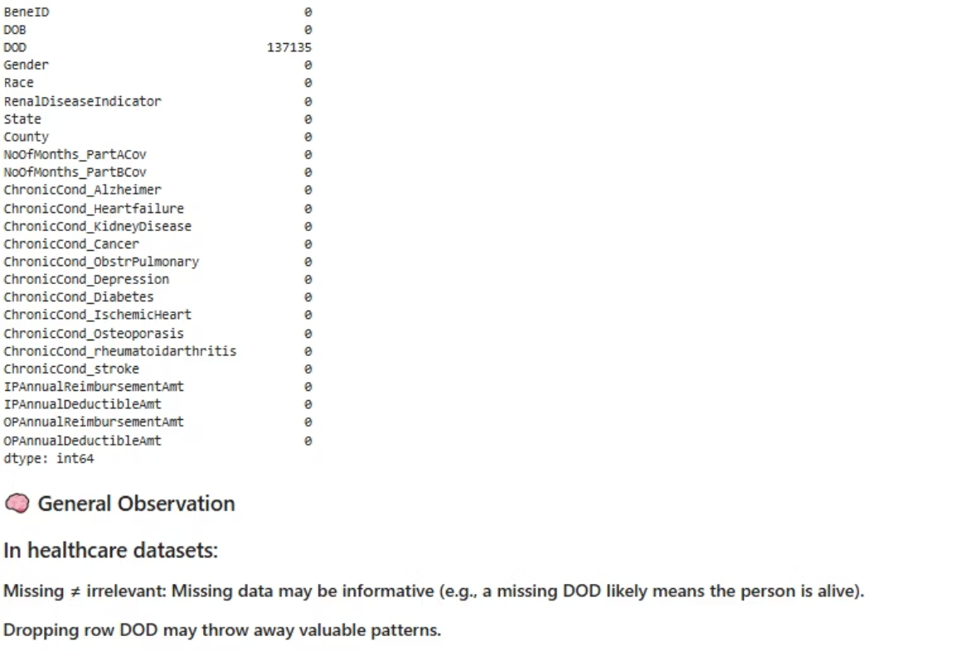
Key Insights:

Slide 6
🔍 Uncovering Key Insights
To dive deeper into our healthcare data, we'll need to:
1
Merge key datasets
2
Correct data types
3
Standardize column names
As we explore the data, we'll need to keep an eye out for some challenges:
Missing values
Highly nullable columns
Certain columns, especially those related to procedures, diagnoses, and physician info, have significant gaps.
Columns with NullProbability close to 1.0 may need special handling or removal.
With a clean, consolidated dataset, we'll be primed to uncover valuable insights through EDA.

Slide 7
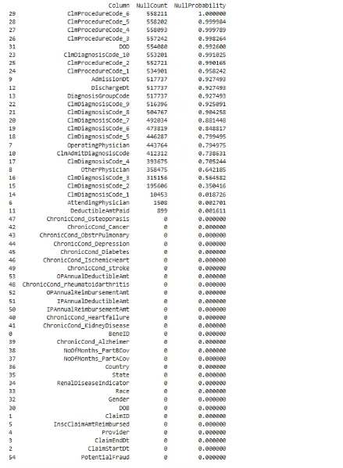
🔍 Diving Into the Data
To uncover valuable insights, we'll first need to prepare our claims data. This involves a few key steps:
1. Merge Inpatient & Outpatient
3. Add Fraud Labels
Combine the inpatient and outpatient claim records into a single, unified dataset. This gives us a complete view of all claims per provider.
Join the enriched claims with our fraud labels, which flag providers suspected of submitting fraudulent claims. This gives us a labeled dataset to train our models.
1
2
3
2. Enrich with Beneficiary Data
Merge the claims with beneficiary information like age, gender, and chronic conditions. This patient-level data is crucial for fraud detection.
With these key preprocessing steps complete, we'll be primed to dive into exploratory data analysis and uncover hidden insights in the data.

Slide 8
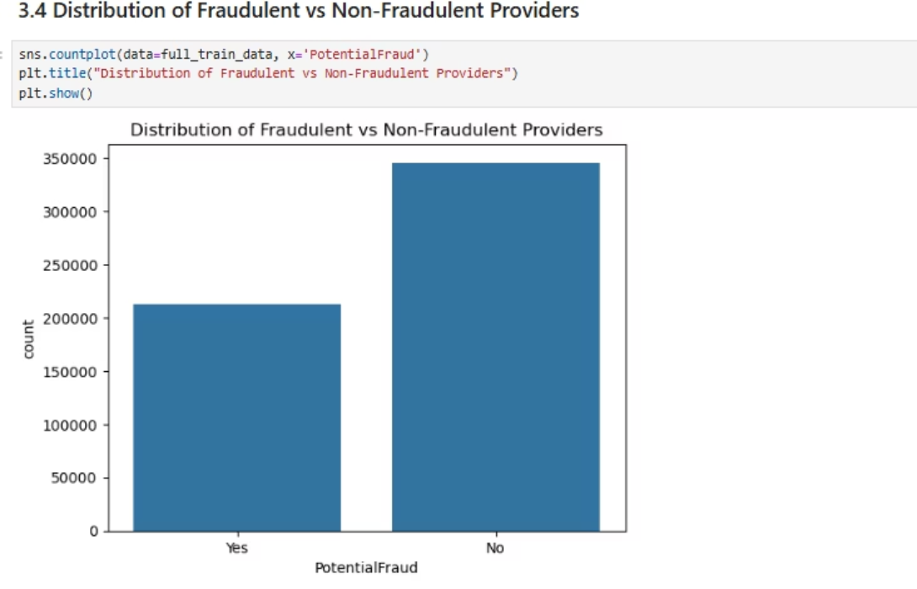
EDA Analysis:
Insight: This is a univariate analysis of "PotentialFraud," showing that most providers are non-fraudulent ("No") compared to fraudulent ("Yes"). The data is imbalanced, with significantly more non-fraudulent cases, which may require attention in predictive modeling to avoid bias.

Slide 9
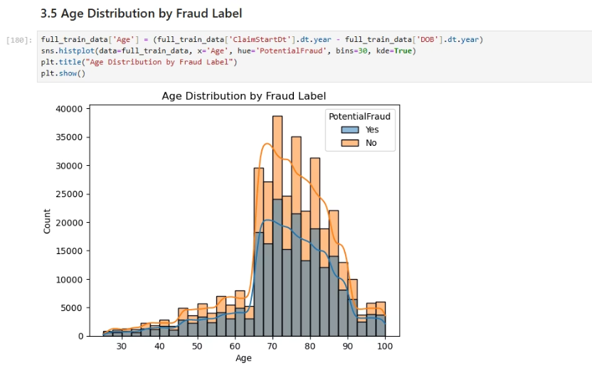
🔍 Observations:
This histogram displays the age distribution of patients with fraudulent and non-fraudulent claims.
Most claims are concentrated between ages 65–85.
Fraudulent claims peak slightly later (around 70–85), suggesting targeted activity among older age groups.
📌 Insight:
While both groups follow a similar distribution, there is a slight increase in fraud prevalence among older patients, hinting at a potential vulnerability or pattern in fraudulent billing.
📝 Conclusion: The analysis above suggests that fraudulent behavior may be associated with:
Higher claim volume per provider.
Higher average reimbursement amounts.
A tendency to target older patient demographics.

Slide 10
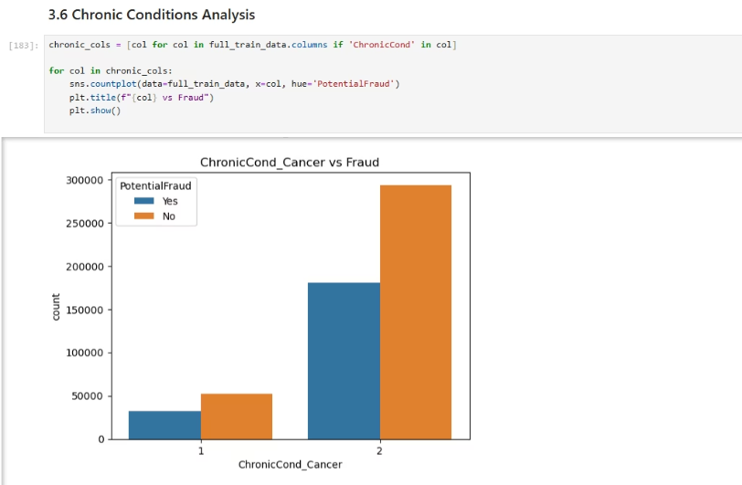
Across all chronic conditions:
Non-fraudulent claims consistently outnumber fraudulent ones.
Conditions like Cancer, Osteoporosis, and Ischemic Heart Disease have high legitimate claim volumes with lower fraud.
Conditions such as Kidney Disease and Depression show higher fraudulent activity compared to others.

Slide 11
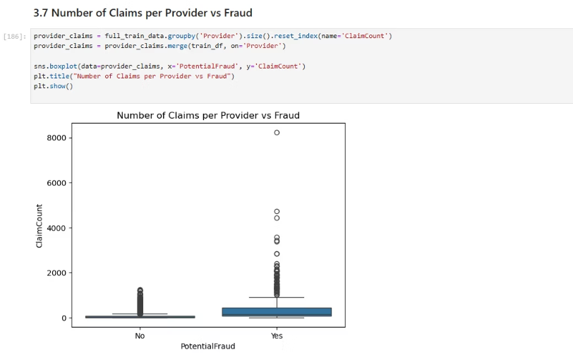
🔍 Observations:
The plot shows the distribution of ClaimCount for providers, split by the PotentialFraud label.
Fraudulent providers (Yes) generally have a higher number of claims.
Several extreme outliers are visible in the fraudulent group, with claim counts reaching over 8000, which is unusually high.
📌 Insight:
High claim counts may be indicative of fraudulent behavior. The visualization highlights that providers flagged as fraud are often associated with significantly higher volume of claims.

Slide 12
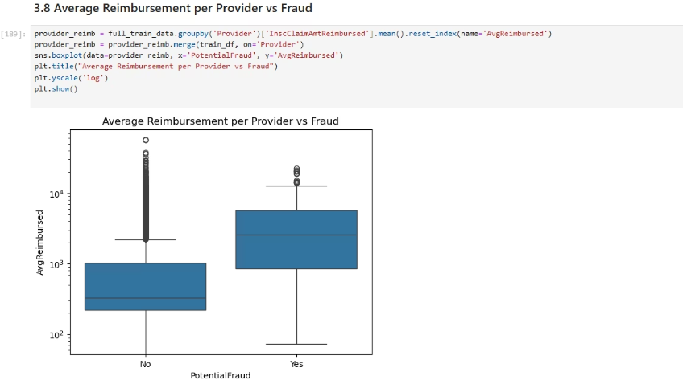
This box plot shows how the average amount reimbursed per provider differs between fraudulent and non-fraudulent providers.
Fraudulent providers ("Yes") have higher average reimbursements compared to non-fraudulent ones.
The distribution of reimbursements for fraud cases is more spread out, with some extremely high values (visible due to the use of log scale).
Logarithmic scale is used on the y-axis to handle the wide range of values and highlight variations effectively.
🔍 Insight:
Higher average reimbursements may be another red flag for potential fraud. Providers with unusually large claim amounts should be investigated more closely.

Slide 13
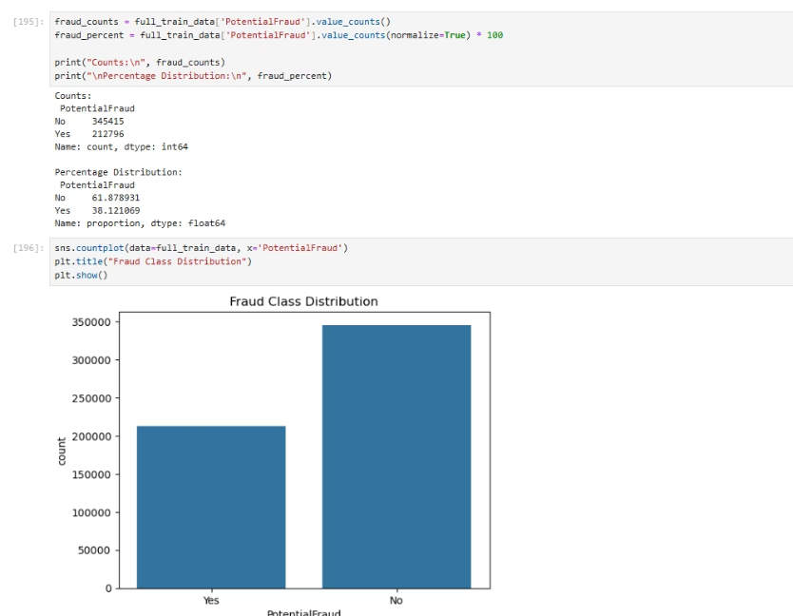
🔍 Plot Description:
The bar plot displays the number of claims categorized as fraudulent (Yes) versus non-fraudulent (No).
Label
Count
Percentage
No (Non-Fraud)
345415
61.90%
Yes (Fraud)
212796
31.10%
📌 Key Insights:
The dataset is imbalanced, with fraudulent claims making up 30% of the data.
Such class imbalance can significantly hinder the performance of standard machine learning models, which may default to predicting the majority class (No) and fail to identify fraudulent cases (Yes).

Slide 14
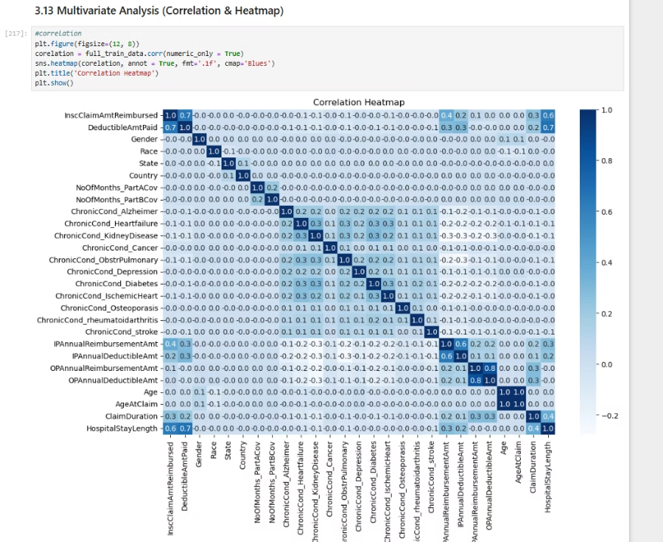
Insights into Chronic Conditions:¶
1. Weak Correlations Between Chronic Conditions and Reimbursements:
Most chronic condition indicators (e.g., Alzheimer’s, Diabetes, Stroke) show very weak correlations with reimbursement amounts.
Business Insight: While these variables might not directly influence reimbursement amounts, they could still play a role in claim patterns or fraud detection. Investigate their influence in combination with other factors (e.g., geographic region).

Slide 15
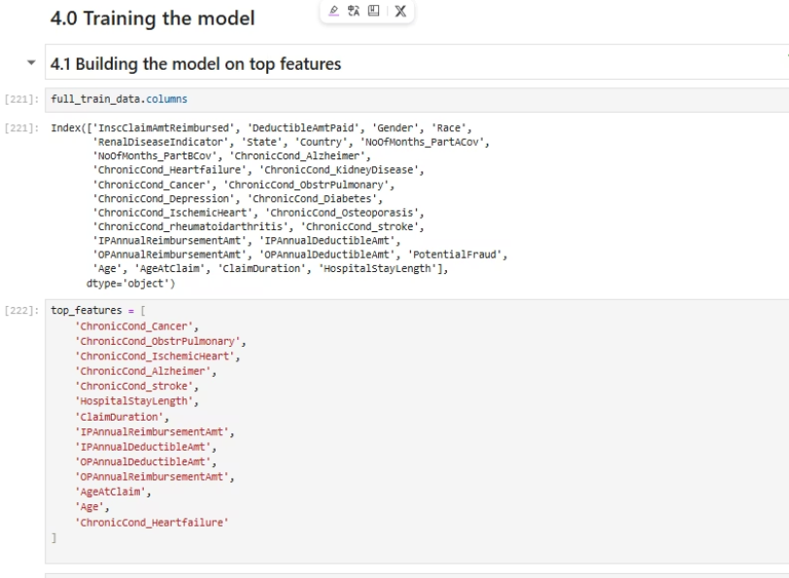
Building the model with the top features predicted to predict Potential Fraud

Slide 16
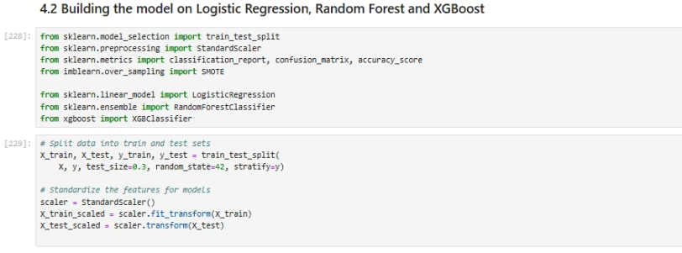
Builded the model on Logistic Regression, Random Forest and XGBoost

Slide 17
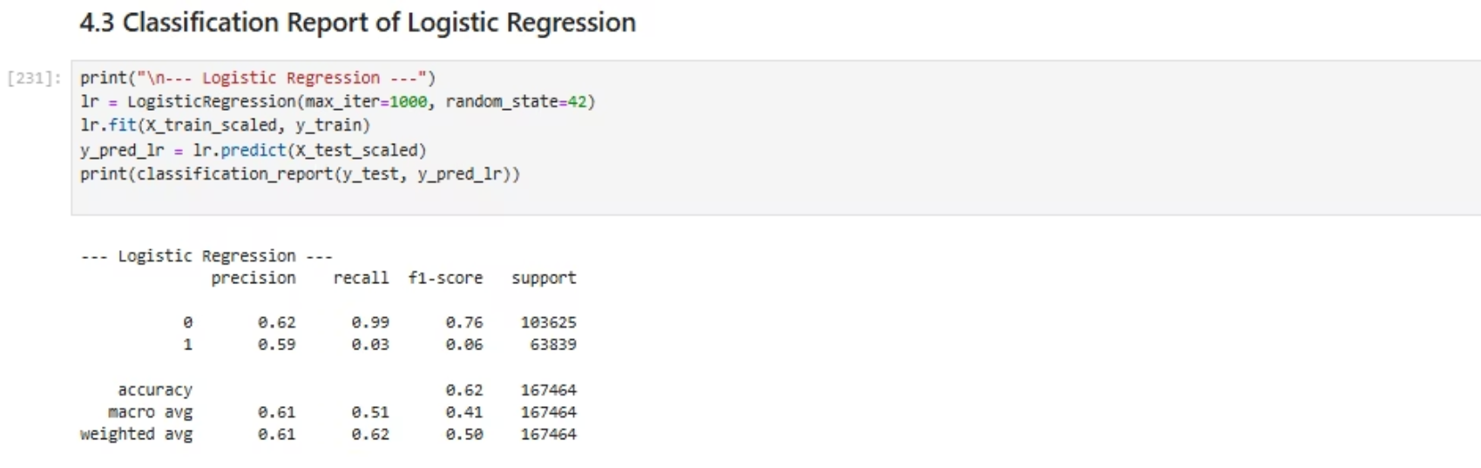
Classification Report:

Slide 18
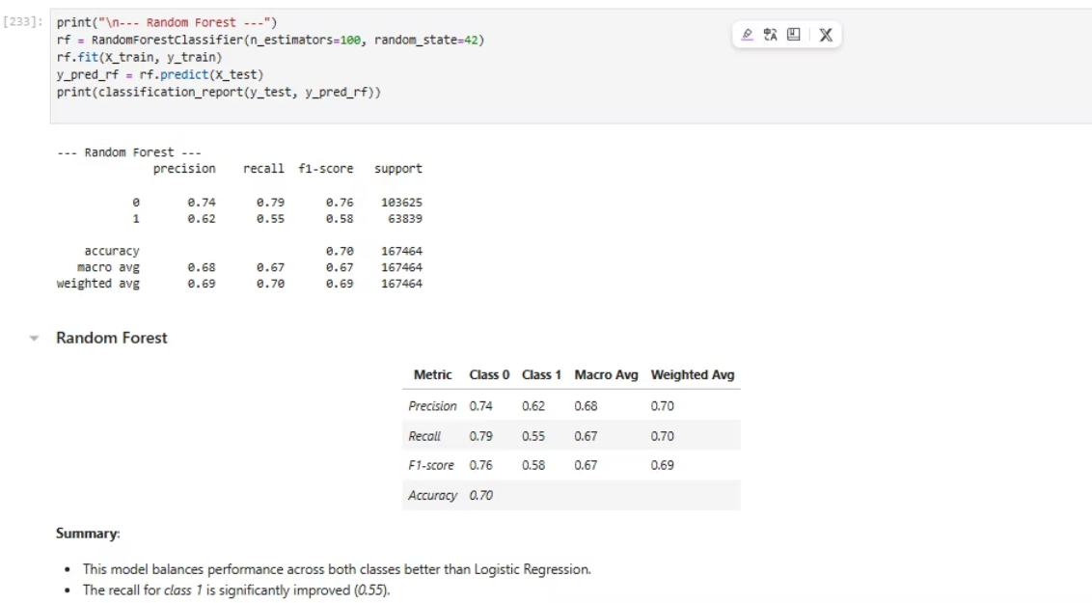
Classification Report for Random Forest

Slide 19
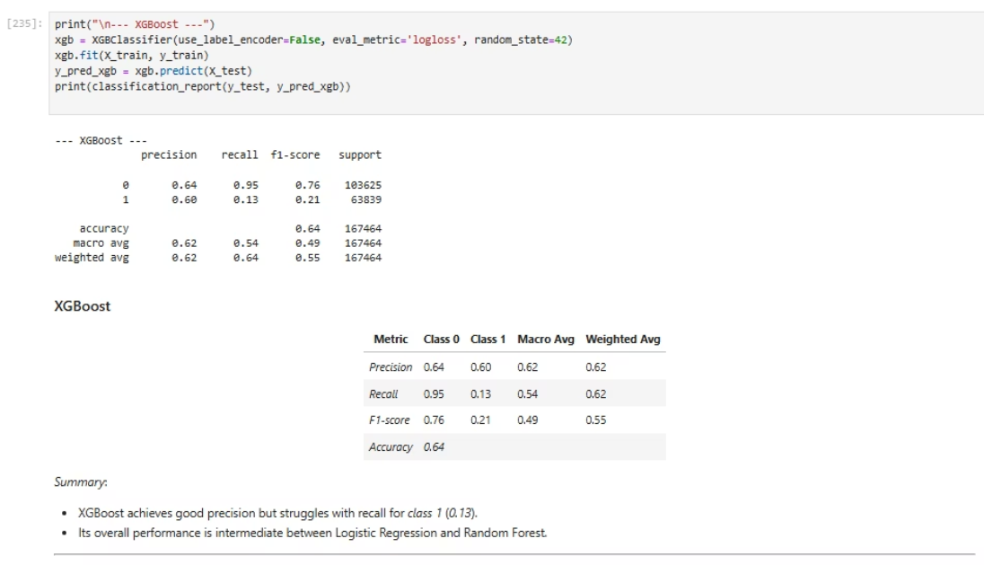
Classification report for XGBoost

Slide 20
Model Comparison
Metric
Logistic Regression
Random Forest
XGBoost
Accuracy
0.61
0.70
0.64
Class 1 Recall
0.03
0.55
0.13
*Class 1 F1-score
0.06
*0.58
0.21
Key Insights:
Random Forest performs the best overall, especially for identifying class 1.
Logistic Regression fails to identify class 1 effectively due to class imbalance.
XGBoost performs better than Logistic Regression but is outperformed by Random Forest in recall, F1-score and AUC score which can be showcased in ROC Curve.

Slide 21
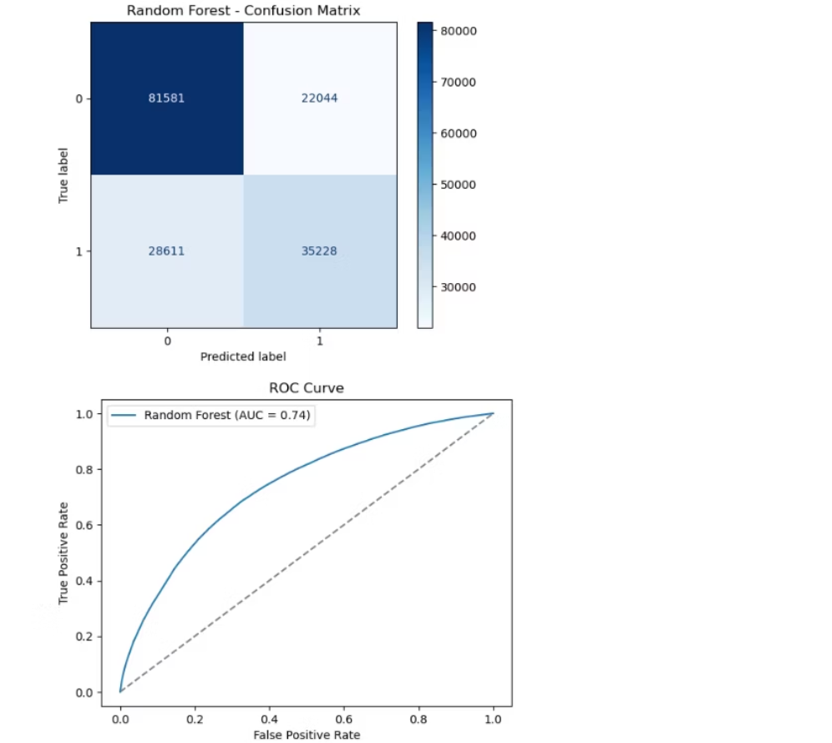
Best AUC Score and RUC Curve between the models is Random Forest.
Random Forest: Confusion Matrix and ROC Curve

Slide 22
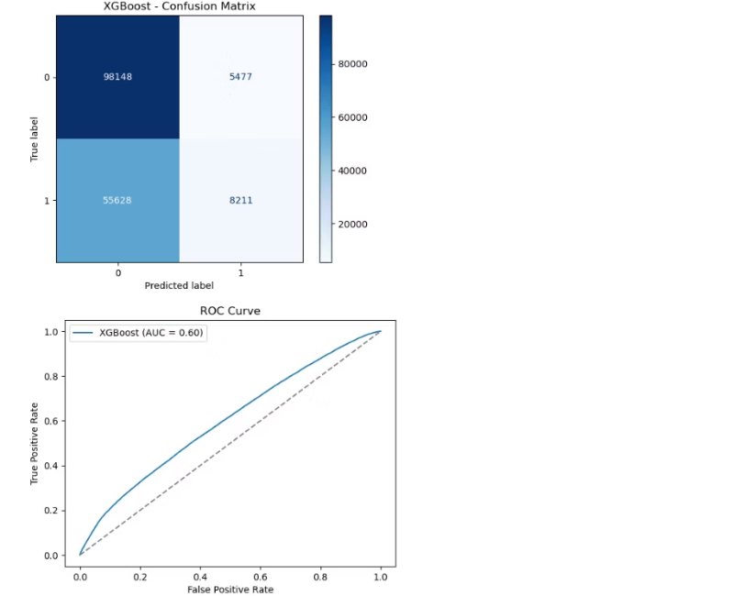
XG Boost: Confusion Matrix and ROC Curve

Slide 23

Logistic Regression: Confusion Matrix and ROC Curve

Slide 24
Conclusion¶
This project successfully addresses the growing challenge of healthcare provider fraud by building a predictive model using structured claims data. Through comprehensive data integration from inpatient, outpatient, and beneficiary sources, we engineered critical features such as hospital stay length, claim duration, and reimbursement patterns.
Using machine learning models like Logistic Regression, Random Forest, and XGBoost, we were able to classify providers as potentially fraudulent or not. Among them, Random Forest delivered the best overall performance. Our analysis revealed that high claim frequency, excessive reimbursement, and certain chronic conditions are strong indicators of fraudulent behavior.
The final model was used to evaluate unseen provider data, enabling insurance companies to proactively identify suspicious providers and reduce financial loss due to fraudulent claims.

Slide 25
Prediction File Name: unseen_predictions.csv

Slide 26
Cloud Deployment: Streamlit Link:

Slide 27
🔮 Future Scope
This project lays the groundwork for scalable and intelligent fraud detection systems in healthcare. Future developments can include:
Real-time Fraud Detection: Integrate the trained model with claim submission pipelines to flag potentially fraudulent providers in real time, enabling proactive action.
Explainable AI (XAI): Leverage techniques like SHAP (SHapley Additive exPlanations) or LIME (Local Interpretable Model-agnostic Explanations) to make model decisions interpretable for compliance officers and stakeholders.
Graph-Based Analysis: Use network/graph theory to model relationships between providers, patients, and procedures to uncover hidden fraud rings or collusion patterns.
Temporal and Sequential Modeling: Incorporate claim history over time using time-series models or LSTMs to capture evolving fraud patterns.
AutoML and Ensemble Methods: Utilize AutoML tools to automatically select and tune high-performing models, or combine multiple models in an ensemble to improve robustness.
Interactive Dashboards: Develop real-time monitoring dashboards for insurers to visualize fraud risk by provider, region, or claim type.
Feedback Loop for Continuous Learning: Retrain models periodically with feedback from audits and investigations to improve detection accuracy over time.
Integration with External Data: Include external datasets such as provider reviews, public sanctions, and geographic statistics to enrich the fraud detection pipeline.
Policy and Audit Optimization: Use risk scores from the model to design targeted audit strategies and customized insurance policies for high-risk providers

Slide 28
Thank You : )

